Slide 1
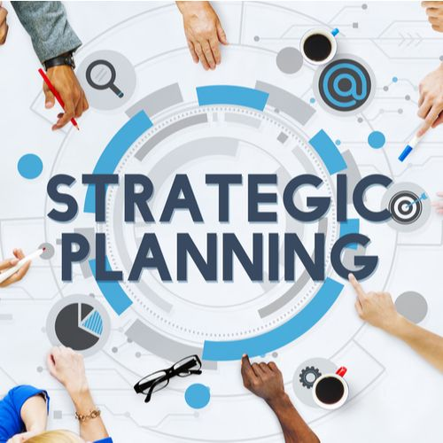
ElderNet
Strategic Plan Material
Background and planning process
Components of the Plan
  Planning Research Topics
  Vision, Mission, Values
  Our Strategy, Strategic Intent, and Goals
Putting the Plan into Action
  Linking Goals to Action Items
  Critical Success Factors and Key Performance Indicators
  Communication and Change Management
Welcome to the Strategic Plan!
This slide deck delves into our planning process and methods, and shows you the results from our rigorous effort.
It also provides education on many strategic planning terms that may be of interest.

Slide 2
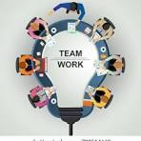

Background
In early 2025, ElderNet reached out to RSVP’s Volunteer Executive Consultants (VEC), for help with strategic planning.
VEC provides free managerial assistance to nonprofits in the greater Philadelphia area through consulting and educational services.
ElderNet went knee deep into the planning process and chose to create a rigorous plan to set the organization’s direction.
ElderNet worked diligently through a Core Team that constructed the Plan and a Review Team to give feedback. VEC provided consulting and education on the planning process. It has been a great team effort.
ElderNet has done a few strategic plans over its 50-year life, but without the deep analysis and actionable strategy found in this work.
The Strategic Plan covers a 5-year outlook with goals spread over the first 3 years.
Slides with the symbol were prepared by VEC to educate on planning topics that may not be familiar to all readers.

Slide 3

Roles for our Planning Process
VEC Team – Consult
  Lead the planning process
  Facilitate design sessions
  Observe and critique
  Make recommendations
Core Team – Construct
  Produce the deliverables
  Active participation in the core team meetings
  Do the assigned homework before and after the meetings
  Have touchpoints with the Review Team
Review Team– Comment
  Represent your constituency
  Participate in review sessions
  Provide feedback on draft deliverables
  Previewing materials before they get released
  Promote the Plan with your constituency
Our planning process called for the Core Team to be introduced to a topic by VEC, conduct the analysis, and collaborate on the findings of each topic as shown on the next slide.
Early topics called for conducting the research required to develop a meaningful strategy. The strategies are then put into action via goal setting.

Slide 4

Team Participants
VEC Consultants: Ray Hoving, Vincent Ahonkhai
Core Team members:
  Michele Raymond, Executive Director (Core Team lead)
  Elizabeth Hill, Board President (Review Team lead)
  Marisa DiSalvatore, Finance and Operations Manager
  Justine Babcock Pantry Manager
  Michelle Buller, Volunteer Manager
  Adela Smith, Secretary
  Lynette Killen – Board Vice President
  Jen Fraim, Case Manager
  Jill Liebling – New Development Manager
Review Team members:
  Beth Drapkin, Assistant Secretary
  Joy Beller Shore, Treasurer
  Michael Corson, Board Member, long time volunteer
  Jared Slipman, Board Member
  Margaret Stevens – Board Member
  Renata Mattson Drozdowski – new Assistant Manager, pantry and office
  Bridget McCabe – new Case Manager

Slide 5
Components of the Plan
Plan Topics
Inputs to Strategy: Benchmarking Program/Function Assessment Core Competencies Collaboration Opportunities (Alliances and Partnerships)
Updated Vision, Mission, Core Values
Strategy, Strategic Intent Statements, linked to Goals
Goals linked to Action Plans
Critical Success Factors (CSF’s), Key Process Indicators (KPI’s)
Change Management and Communications Plan

Slide 6

Benchmarking
Benchmarking involves comparing an organization’s performance to others in similar businesses to identify areas for improvement.
  Anticipate and respond to the changing customer needs and expectations.
  Stay ahead of the curve.
  Serve as input to creating your business strategy.
Target organizations for benchmarking can be non-profit or for-profit.
  The best matches would be of organizations having similar programs as ElderNet.
  Organizations that compete with ElderNet for funding are ideal.
Criteria to evaluate
  Size and scope of geographic coverage
  Program Capability – what they do better; what we do better
  Their branding capability, plusses and minuses
  Cost or fee structure, if any
  Quality and content of their Strategic Plan, if they have one
  Take aways from the benchmark: what can we do better

Slide 7
Organizations we Benchmarked
26 different organizations
Good mix of local and remote geographies
Several very large organizations and a few smaller than ElderNet
Some are nationwide focusing on education and advocacy
Benchmarking Organizations
PALM
RSVP
Elder Helpers
OPTIONS
Central Behavior Health
Home Instead
American Society on Aging
Surrey Services
Neighbors Helping Neighbors on the Main Line
Project Hearth, Pottstown, PA
Senior Community Services of DelCo
Seniors Helping Seniors
Sound Generations, Seattle
Benchmarking Organizations (continued)
Partners in Care-Maryland
Senior Citizens United Community Services-Audubon NJ
Inter Faith Caregivers-Haddonfield Heights, NJ
Knoxville Community Action Committee CAC
Senior Services of Southeastern Virginia
Dauphin County Area Agency on Aging
Keystone Community Services
Center at Journey’s Way
Aging Forward
ACLAMO Montgomery County
Boyertown Area Multi Service Center
Fisherman’s mark - Lambertville, NJ

Slide 8
What we do better than most
Free vs fee
Food Pantry
Reliable transportation
Attract younger volunteers
Care management/companionship
Emergency Financial support

Slide 9
What some do better than us
Broader range of services such as
  In home counseling
  Mental health
  Medicare assistance
  Medication services
  IT assistance
  Community Centers
  Med-alert, emergency response systems
  Weatherization
  Lawn service
  Recreational
  Cleaning services, household chores
More well known in their communities
Provide education, awareness, issue advocacy
Multi-lingual
Support families

Slide 10
Possible actions we could take from benchmarking
Increase range of services
Increase geographical coverage
Align with partner organizations
Van with wheelchair access
Non-essential rides
Extend pantry hours, mobile food, pre-cooked meals
Improve website with more information, engaging literature
“Honey do crew”
Education for seniors
Increase reputation via Best Practices, and Advocacy

Slide 11
Recap of Programs Assessment
Volunteer
  Strong base, but still short capacity
  Good on-line scheduling although not well linked to Care Mgt system
  Value of volunteers bonding with participants and communication of principles
  Most all comments were about volunteer riders, little said about other areas such as in food bank, social workers, reception, home repairs, etc.
Food Bank
  Solid operation, good sources of food
  Recent facility improvement but still short of space
  Desire to improve wait times, extend hours, increase food supply, focus on nutrition
  Partnership opportunities with food groups and religious organizations
Care Management
  Recent improvement with staffing
  Policies/procedures in place but needs more clarification
  Still have boundary issues: how far to support participant needs
  Internships, volunteers, partnerships to expand scope of service

Slide 12
Recap of Internal Functions Assessment
Marketing/Visibility
  Improving local visibility via social media
  Not well known regionally
  Need to change up promotional materials
  Build more relationships with agencies and health providers
Board of Directors
  Improved relationships with Staff, focus now is on governance versus operation
  Board diversity remains an issue
  Good Board engagement, but not by all
  More comments on this category than any of the others, high level of interest
Staff Development
  Stable, skilled and dedicated staff; good collaboration, weekly interaction
  More need for professional development via training and experiential learning
  Sharing of best practices, learnings
  Physical space issues

Slide 13
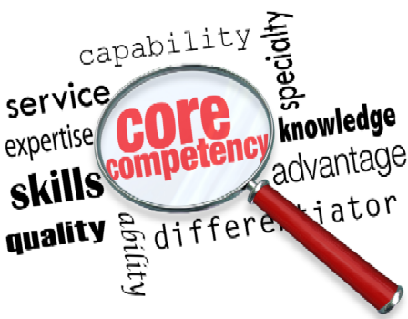
Core Competencies
In 1990, two business academics, C.K. Prahalad and Gary Hamel, teamed to write one of the Harvard Business Review’s most influential articles: The Core Competence of the Corporation
Core competencies are essentially what a business does well that distinguishes it from other businesses.
The term core competency has evolved to be suitable for small businesses and non-profits. All definitions, however, include the concept of competitive advantage.
Successful businesses tend to have more than one but only a few core competencies.
Cultivating core competencies also means benefiting from alliances.

Slide 14
ElderNet Core Competencies
Core Competencies | Supporting Comments
Volunteer Program | Management of the volunteers is seamless and offers an opportunity for neighbors to support neighbors. Volunteers are trained and share best practices. Good software program makes volunteering easy. Rides and Friendly Visitor Program are central services.
Food Pantry | Operates with dignity, meeting people where they are, allowing the shopping experience to be individualized. Unique to the pantry is our ongoing distribution of personal care items, paper goods, and pet food. We emphasize free choice compared to handing out standard pre-packed bags.
Care Management | One on one participant support that is tailored to the immediate needs, while looking down the road to provide on-going services and partnership with other agencies. Provide both SIS (Senior Intensive Services) as well as I&R (Intake and Referrals) Full-time, dedicated social workers.
Knowledge of Community | ElderNet can be bridge between community and other orgs. Our staff and volunteers’ knowledge of the shared community enables superior service. Our community knowhow attracts a solid donor base.
Free Comprehensive Services | No other organization offers the full menu in our geographic footprint. This includes free door through door service.
Deep Rooted Values | Based on a 50-year culture that enables our mission and value statements to survive through thick and thin; and to our organizational commitment of going “above and beyond”.

Slide 15

Partnership (a.k.a. Alliance) Opportunities
A Partnership is a collaboration that an organization enters with one or more parties to meet the needs of each party.
Non-profit partnerships allows various organizations to join together and make even bigger strides in bettering their community.
In addition to linking with other non-profits, partnerships can be with for-profit companies. Many corporations include in their mission to give back dollars and employee time to the communities in which they operate.
A partnership can also be with government agencies. Charitable non-profits and governments are natural partners, serving the same constituents in the same communities.
Some successful partnerships can also be with competitors, via the “Coopetition” model, where organizations both compete and collaborate.
There are two types of partnerships: standard and strategic
  Standard Partnerships can be as simple as a supplicant-benefactor relationship. For example, the non-profit seeks funding from another organization, charitable or municipal. Standard partners can also be who ElderNet collaborates with to enhance their programs.
  A Strategic Partnership is a special form that becomes central to each organization’s mission and integral to their strategies. Both deploy and combine their core competencies, joint activities proliferate, personnel and institutional relationships multiply, and trust deepens. They are designed to leverage the unique strengths of each party to achieve a common goal.

Slide 16
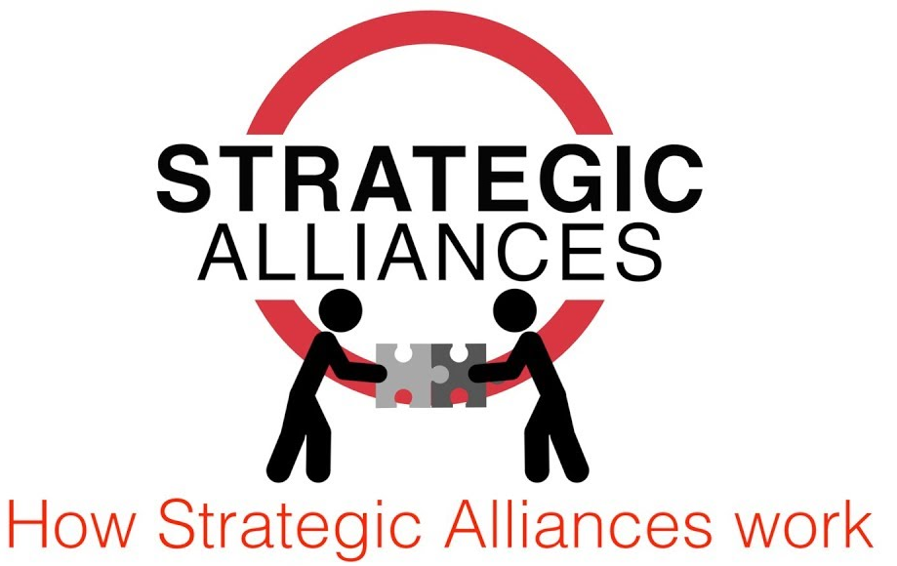
Essential Ingredients for a successful Strategic Alliance
Purpose
Identifying the ‘why?’ is critical to successful outcomes. What is it about this alliance that suggests working together is going to be more valuable and productive to working independently?
Outcome
Clearly define the outcome that both alliance partners seek to achieve. If one is the beneficiary at the expense of the other then the alliance will fail to deliver.
Trust
Developing trust requires continuous effort through respect. By developing positive relationships and focusing on creating solutions and not blame. Communication is key to building trust.
Compatibility
Assessing compatibility in terms of organizational culture, values, and strategic priorities ensures alignment and minimizes conflicts.
Adaptability
Being prepared to adapt to changes in the market, technology, and business environment is crucial for long-term success.
Complementary Strengths
Successful alliances leverage the unique strengths and capabilities of each partner to achieve better outcomes.
Exit Strategy
An exit strategy is also worth building into the plan from the start. By both parties agreeing how they can exit should the worst happen and the alliance turn sour is an acknowledgement of the risk and the trust required.
Ownership
There must be a clear level of ownership and accountability. Defining the roles and responsibilities and having a weekly cadence and reporting mechanism is crucial.
Patience
Alliances, as living breathing systems will take time to develop and need the time to grow. Look for and celebrate the short-term wins while keeping an eye on the longer-term strategic objectives.

Slide 17

Observations from the Alliance Analysis
27 alliances Identified
Wide variety of alliances
  Sources of food and materials
  Healthcare connections
  Government
  Foundations
  Service providers
  Promotional opportunities
  Religious groups
Solid base of 18 current alliances
9 good potential alliances - mostly strategic
Need to select among the most promising strategic leads and begin the exploration

Slide 18
Variety of Alliances – Current and Potential
  Sources of food and materials
    Philabundance
    MAHN - Mont-Co Anti-Hunger Network
    SHARE Food Program
  Healthcare connections
    Main Line Health
    Penn Medicine
  Government
    Lower Merion Township
    MontCo Aging and Adult Services
  Foundations
    25th Century Foundation
    Saunders House
    Gordon Charitable Foundation
    Armstrong Foundation
    Other foundations
  Service providers
    Surrey Services
    U of Penn internships
    Bryn Mawr College internships
    Neighbors Helping Neighbors Admore
    Ardmore House 1 & 2
    Lower Merion Counseling
    Transportation-Transnet; Septa; Uber
  Promotional opportunities
    Main Line Chamber of Commerce
    Ardmore Initiative
    Bryn Mawr Rotary
  Religious organizations
    Ardmore Methodist
    Bryn Mawr Presbyterian
    Church of Redeemer
    St Thomas of Villanova
    Other religious organizations

Slide 19
Alliances Identified by Type
Standard – Current (12)
  MontCo Aging and Adult Services
  Saunders House
  Gordon Charitable Foundation
  Armstrong Foundation
  Other foundations
  Ardmore House 1 & 2
  Trans-Transnet; Septa; Uber
  Ardmore Methodist
  Bryn Mawr Presbyterian
  Church of Redeemer
  St Thomas of Villanova
  Other religious organizations
Standard – Potential (1)
  Bryn Mawr Rotary
Strategic – Current (6)
  Philabundance
  MAHN - Mont-Co Anti-Hunger Network
  Main Line Health
  Bryn Mawr College internships
  Lower Merion Township
  25th Century Foundation
Strategic – Potential (8)
  SHARE Food Program
  Penn Medicine
  Surrey Services
  Neighbors Helping Neighbors Admore
  Lower Merion Counseling
  University of Pennsylvania internships
  Main Line Chamber of Commerce
  Ardmore Initiative
The idea here is to select from the potential candidates to engage in discussions of forming an alliance which benefits both parties.

Slide 20

Introduction to Vision, Mission, and Values
Vision – What we are - looking out
Mission – What we do and why we do it - now
Values – What we believe - always

Slide 21

Vision
Inspires the listener
Appeals to the senses
Possible if not practical
Motivational
Inspirational
Emotional
Connects to mission and values
A vision is a short statement about what your organization becomes. It should resonate with all members of the organization, and help them feel proud, excited, motivated and part of something much bigger than themselves.

Slide 22
Mission
A succinct expression of an organization's essential purpose and reason for existence; articulated for those in the organization and for the public.
Broadly describes an organization's present capabilities and serves as a roadmap for the company's vision statement.
Could include what kind of product or service it provides, its primary customers or market, and its geographical region of operation.
Linchpin to Vision and Values

Slide 23

Core Values
Core values define what your organization believes and how you want your organization resonating with and appealing to employees and the external world.
Core values become integrated with the beliefs of your employees and affiliates such that customers and vendors see these core values in action.
Value statements are declarations about how the organization will interact among employees, affiliates, customers, and suppliers.
Value statements define how people want to behave with each other. They provide a measuring device against which you evaluate all of your actions and behaviors.

Slide 24
New ElderNet Vision and Mission Statements
Our Vision:
ElderNet envisions a community where elders and disabled adults can thrive in their own homes with dignity and connection, supported by compassionate services, meaningful volunteerism, and a community-wide commitment to care.
Our Mission:
ElderNet empowers elders and disabled adults in need to remain living in their homes by reducing barriers to healthcare, nutritious food, public benefits and meaningful social connections.

Slide 25
ElderNet Core Values
Core Value | Description
Respect | ElderNet treats people with dignity and respect by building trust and recognizing that every person regardless of age or ability deserves to be valued without judgement.
Volunteerism | Volunteerism embodies ElderNet’s aim to mutually benefit the larger community and the volunteers by providing companionship, giving back, and finding purpose while offering needed services.
Community | We collaborate among community assets to find synergies with partners, encouraging neighborly support to meet community needs, and offering a sense of belonging.
Well-being | ElderNet believes in safety and security for elders and disabled adults and aims to provide services and support systems that protect their physical well-being, emotional health, and ability to age in place.
Compassion | At ElderNet, compassion and empathy shape every aspect of how we serve elders and disabled adults. We strive to understand the lived experiences of the people we serve and to respond with kindness and humility.
Dependability | We build enduring relationships that foster trust by consistent responsiveness and reliable service quality.
DEIA | We embrace diversity, equity, inclusion, and access as strengths, and actively work to create welcoming spaces for people of all backgrounds and identities.

Slide 26
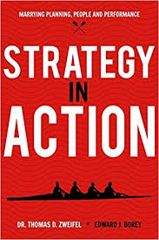
How we put Strategy into Action
This shows the linkage of our planning documents that enables us to put the Strategy into Action. The Plan becomes real.
Strategies (compelling phrase or visual)
  Strategic Intent Statements
    We intend to . . . (insert direction) by . . . (insert how going to get there)
    Goals (achievable milestones with success measures)
      Actions (sequenced time-based activities to meet the goals)

Slide 27

Strategy
Your Strategy is the most important reflection of your organization’s Vision, Mission, and Values.
Some organization’s Strategy is built into its fabric without being explicitly stated.
Some have a short, concise writeup articulating the Strategy for others to follow.
A technique for explaining your Strategy is via Strategic Intent Statements.

Slide 28

Strategic Intent
  Strategic Intent folds the future back into the present; a merger of Vision and Mission. It envisions a desired leadership direction and establishes the criterion the organization will use to chart its progress.
  Is more than unfettered ambition. It encompasses an active management process, generating the desired pattern of decision making when communicated and adopted in the organization.
  Implies a sizable stretch for an organization. Current capabilities and resources will not suffice. This forces the organization to be more inventive, to make the most of limited resources.
  Provides consistency to short-term action, while leaving room for reinterpretation as new opportunities emerge.
Excerpts from HBR article by Gary Hamel & C.K. Prahalad, 2005

Slide 29
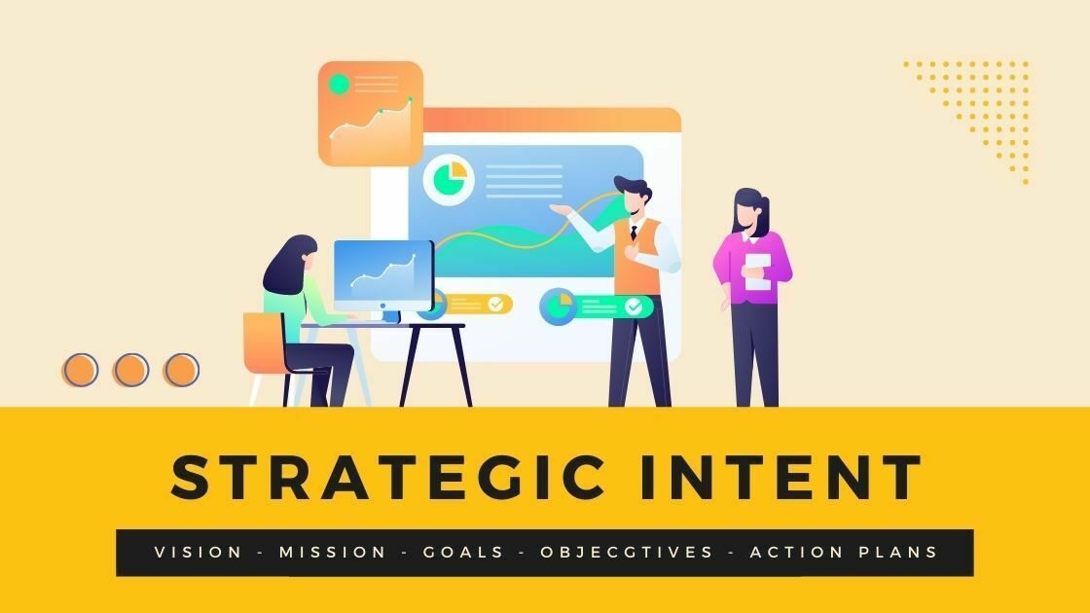
Strategic Intent Statements
Succinct descriptions of the directions the organization is going to take and how it will get there
Focuses on new strategic directions while reaffirming critical current directions
Stated as “we intend to . . . (insert direction), by . . . (insert how going to get there)”
Are linked to one or more goals with milestones
“Strategic people create connections between ideas, plans, and people that others fail to see” HBR

Slide 30
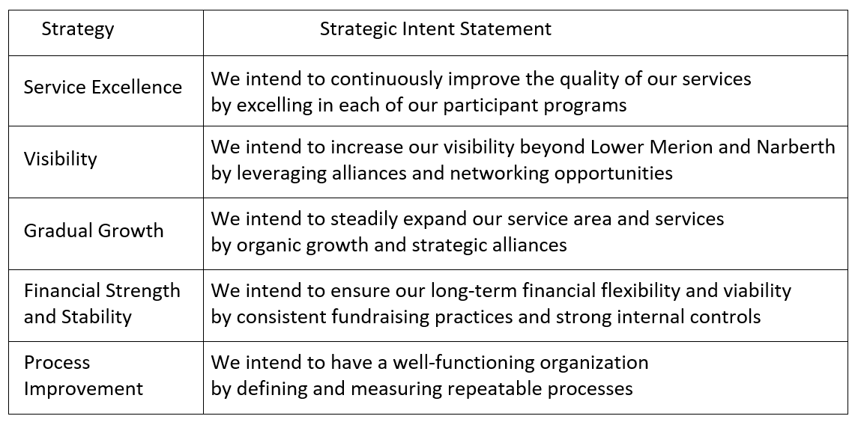
Linking Strategy to Strategic Intent

Slide 31

Goal Setting Principles
  Make sure they are in sync with your Vision, Mission, Values; and your Strategies.
  Make them SMART - specific, measurable, achievable, realistic, and time-based.
  A goal without a measurable outcome is like a game without a scoreboard or scorekeeper.
  Goals connect to time dependent actions items with resources assigned.
  Create a road map with the action items for exactly how you’re going to reach each goal.
  Push yourself to think big while having some quick hits that will reinforce positive results.
  Pick realistic scope, time and resource commitments; resetting as needed.
  Stick to your commitments. Stay motivated to see your goals through to the end.
  Make your goals visible to stakeholders; involve them in the effort.
  Celebrate the success of completed goals.

Slide 32
Goal Owner Role
Accountable for the success of the goal
Identifies action items and assigns responsibility
Adjusts the implementation plan as conditions change
Communicate changes to your goal that may impact other goals
Monitors progress, success measures, and reports on status
Assesses risks and takes steps to prevent them
Applies Project Management principles
Celebrates completion of milestones

Slide 33
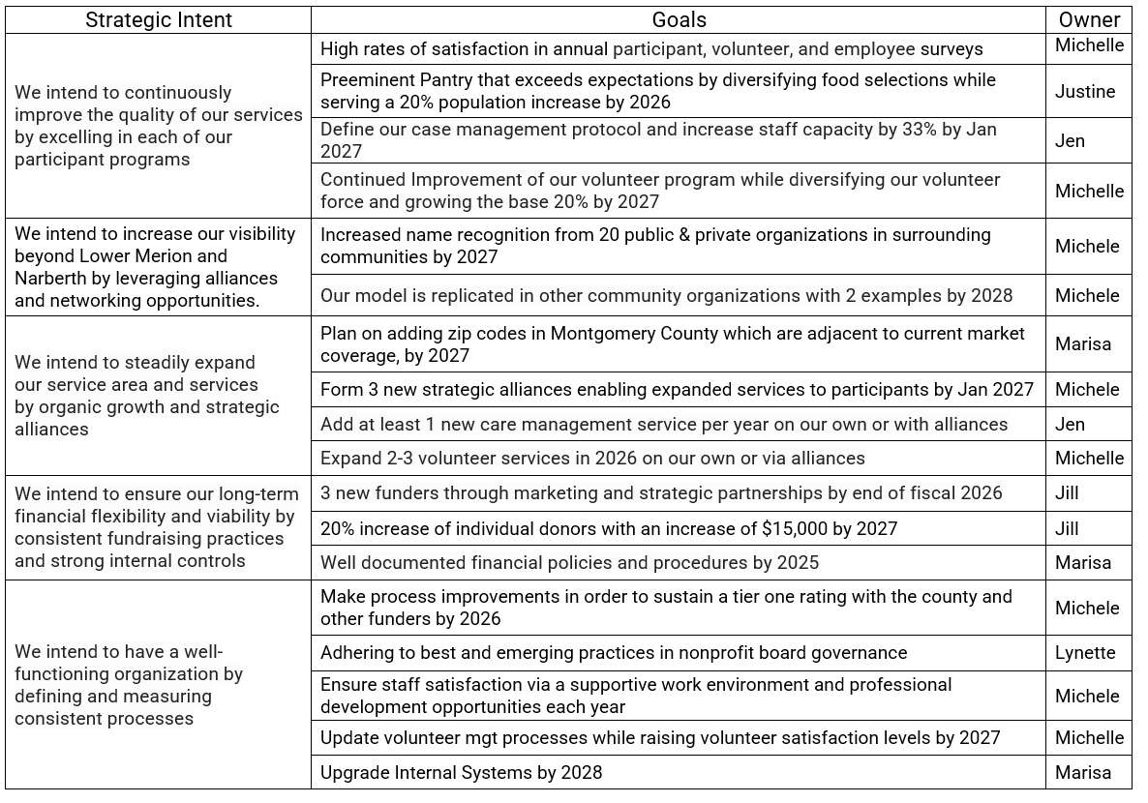
Linking Strategic Intent to Goals on one slide

Slide 34

Action Planning
Plans don’t work unless they are implemented
Implementation doesn’t work unless actions are identified
Actions don’t get done unless resources are committed
Actions don’t get done well unless they are logically connected:
  Vision, Mission, and Values drive Strategic Intent
  Strategic Intent drives Goals
  Goals drive Action Items

Slide 35
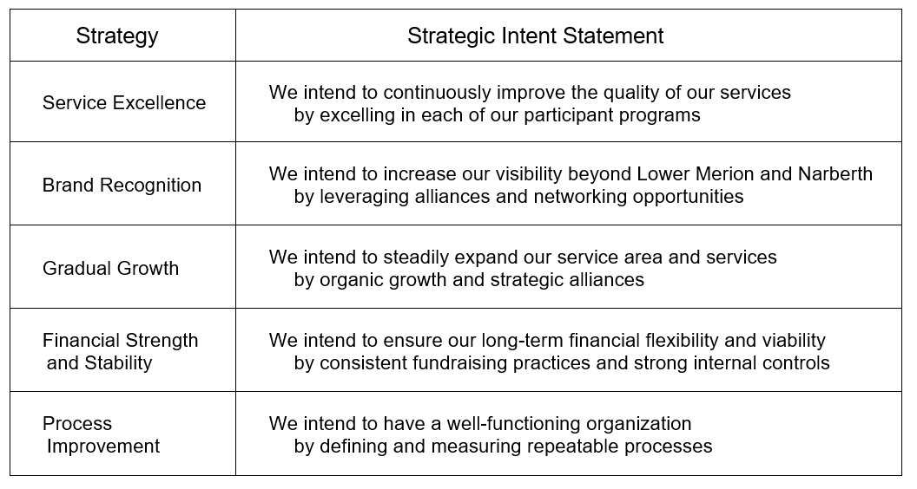
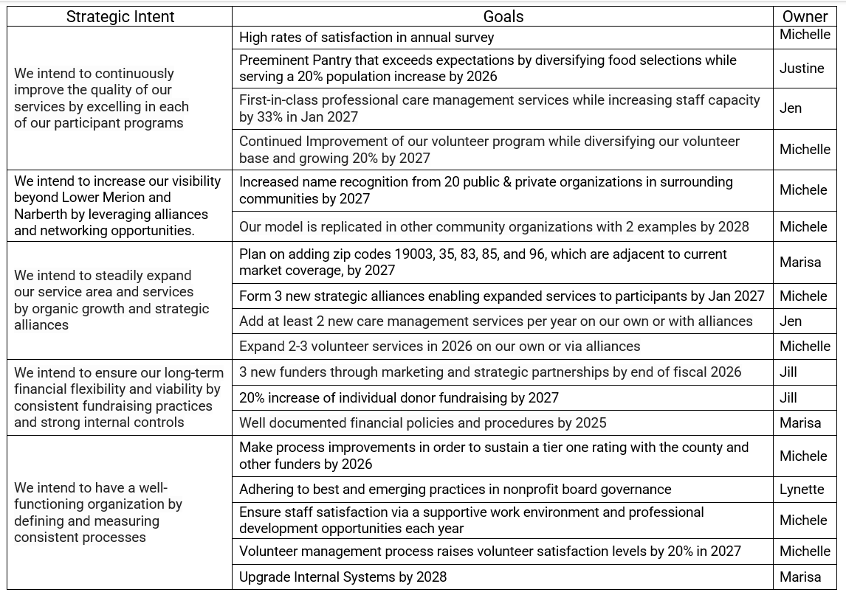
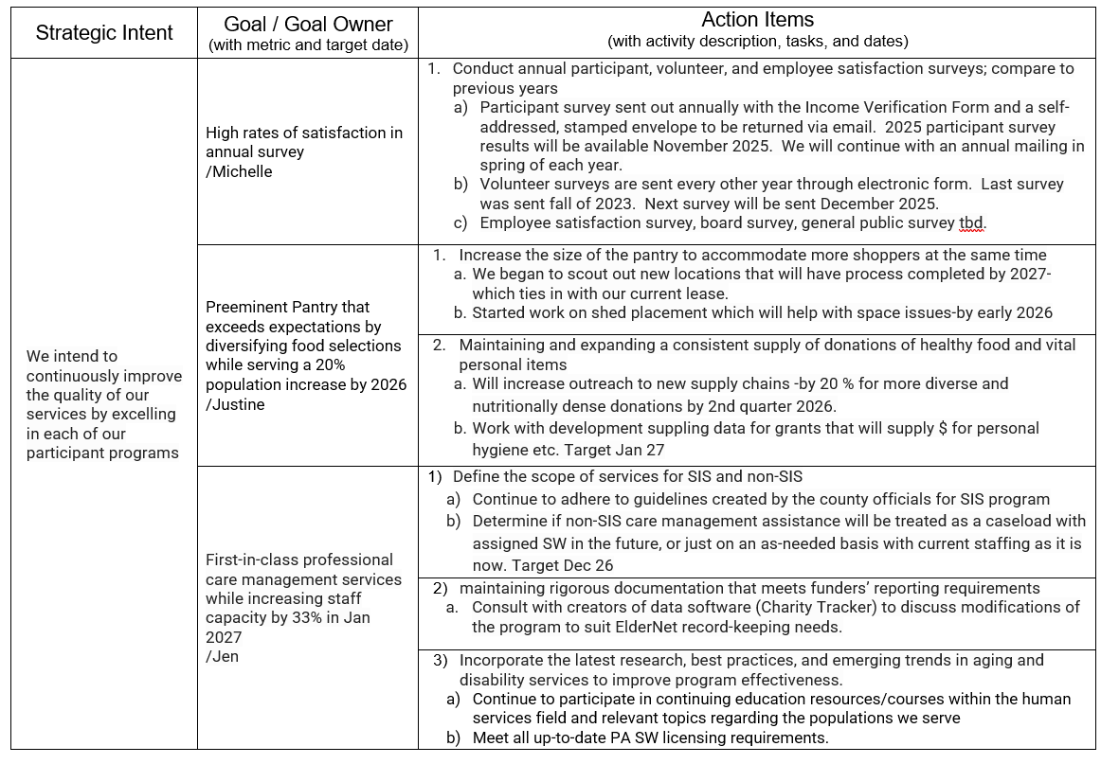
Strategy to Action Progression
  5 Intent Statements
  18 Goals
  60 Action Items

Slide 36

Critical Success Factors – CSF’s
Introduced by Jack Rockart, MIT in 1980 as:
High level, broad, and holistic
Usually expressed in tactical terms
Should be just the few items that really matter
Clear and simple so that everyone knows exactly what's most important
Should receive constant and careful attention from management
Those few outcomes which must go right for the organization to achieve its Mission and Strategy

Slide 37
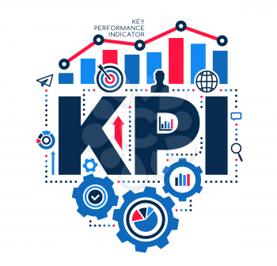
Key Performance Indicators – KPI’s
Also introduced by Jack Rockart, MIT in 1979 as:
A KPI is a specific, measurable number that shows progress toward an objective.
Provides an analytical basis for decision-making and ensure resources are aligned.
A balanced set of KPIs includes both measures of the current operation, as well as those needed to achieve strategic objectives.
It is better to have a few KPI’s (around 6), rather than being overwhelmed by a dense dashboard.
The few quantifiable key metrics to ensure an organization achieves its Mission and Strategy

Slide 38
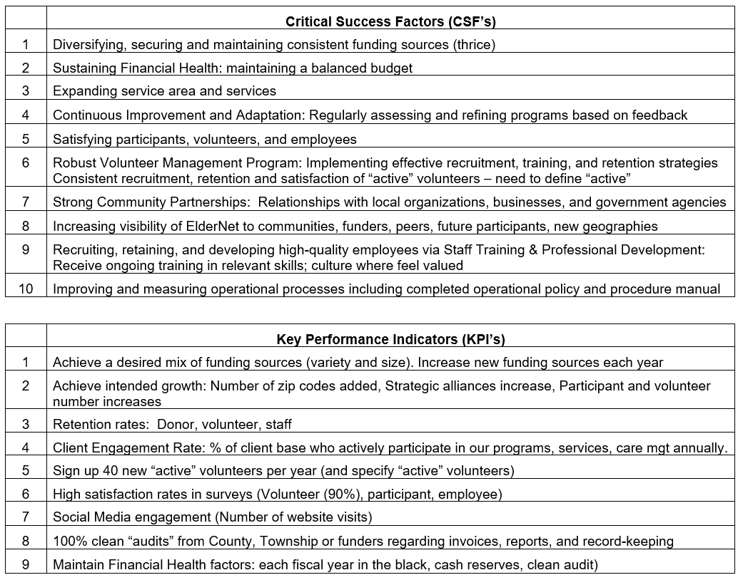
ElderNet CFS’s and KPI’s:

Slide 39
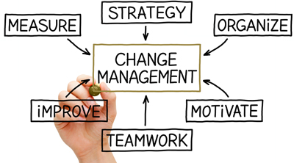
Change Management
Change management is the discipline that guides how we prepare, equip and support individuals to successfully adopt change in order to drive organizational success.
Studies have shown that initiatives without, or with poorly designed change management fail about 80% of the time, while use of well-designed change management approaches creates an 80% success rate.
Organizational change management involves
  Identifying the stakeholders who will need to change as the result of the project, and in what ways they will need to change.
  Creating a customized plan for ensuring those impacted receive the awareness, leadership, coaching, and training they need in order to change successfully.

Slide 40
Stakeholder Impact Analysis and Change Management methods
Impacted Groups | How will they could be impacted positively | How will they could be impacted negatively | Change Management Approach to increase acceptance and lower resistance
Clients (Participants) | Improved clarity, quality, and consistency of service Expanded services | Defined services may seem confusing, restrictive and less personal | Clear, simple communication explaining what is changing, why, and benefits to them Repetitive one-on-one explanations by staff and volunteers
Volunteers | More opportunities with clearer expectations and procedures | Loss of neighborhood feel and autonomy Stricter adherence to guidelines | Present changes and why they matter to volunteers in advance Regular training, onboarding, and refreshers
Staff | Clearer processes, protocols, and documentation Seeing the plan implemented | Stricter adherence to guidelines Change fatigue | Gather staff input as we move through the changes on how to best implement Training, coaching, and peer support
Board | Stronger governance practices and clarity of responsibilities | More is asked of them Doing community outreach | Regular updates tied to strategic plan goals Emphasize importance of Board being “ambassadors”
Funders | Clearer outcomes, metrics Evidence of long-term sustainability and growth | Concern about budgetary risks or expansion pace Short-term reporting adjustments | Proactive communication about improvements and transitions Clear alignment between funding and outcomes
Community Partners | Increase bonds and trust with them Clearer referral pathways and expectations | Adjustment to new referral criteria or processes Coordination during expansion | Early outreach and relationship-based communication Regular check-ins and shared problem-solving
Alliance Partners | Win/win for strategic and standard partners Mutually beneficial expansion | Time required to establish MOUs and align expectations Concern about turf, autonomy, roles | Reassure partners/alliances that changes will be supportive of their mission Ongoing communication and evaluation
Health Care providers | Improved coordination and referrals for shared participants Expanded support options | Might not like increased load Additional coordination effort initially | Clear referral materials and FAQs Ongoing relationship management

Slide 41
Change Management Conclusions
Across all stakeholder groups, three dominant themes emerged:
  Clarity reduces resistance – Clear scope, expectations, and communication are consistently viewed as more beneficial than harmful, even when limits are introduced.
  Phased implementation is essential – Nearly all groups emphasized the importance of gradual rollout to avoid confusion, fatigue, and disruption.
  Inclusion builds trust – Early engagement, feedback opportunities, and transparent leadership significantly increase acceptance and long-term buy-in.
Change Management Approach:
  Purpose: Build awareness, trust, and adoption of the Strategic Plan
  Approach: Clear, consistent, and stakeholder-specific communication
  Principles: Plain language, phased rollout, emotional awareness, feedback loops
  Success: Reduced confusion, aligned messaging, sustained engagement

Slide 42

Wrap-up:
Thank you for reviewing this PowerPoint deck and for your interest in our Strategic Plan
We'd be happy to hear your comments and answer your questions

